Slide 1

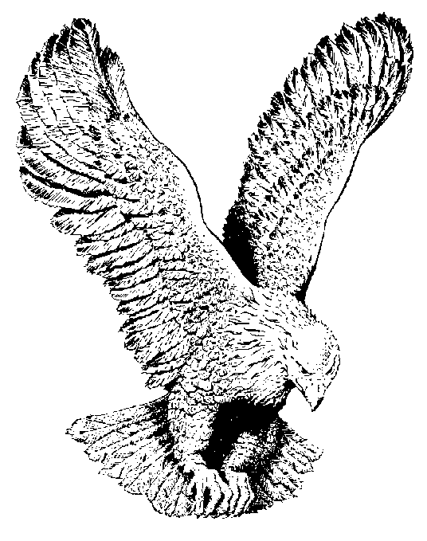
89
MUST JESUS BEAR ALONE?
Must Jesus bear the cross alone,
And all the world go free?
No, there’s a cross for every one,
And there’s a cross for me.

Slide 2
The consecrated cross I’ll bear,
Till death shall set me free,
And then go home my crown to wear,
For there’s a crown for me.

Slide 3
Upon the crystal pavement, down
At Jesus’ pierced feet,
With joy I’ll cast my golden crown,
And His dear name repeat.

Slide 4
O precious cross! O glorious crown,
O resurrection day!
Ye angels from the stars come down
And bear my soul away.

